Slide 1
Lecture 21
Computer Security Ethics

Slide 2
Before we start…
Being ethical is not necessarily following one’s feelings;
“feelings frequently deviate from what is ethical“
Often because of the way one is raised, ethics and religion are coupled; but ethics is not confined to religion nor is the same as religion
Being ethical is not solely following the law.
Elements of practical ethics through basic philosophy:
Ethical thought
Ethical definition
Ethical values
Example: “If a person conceives of engineering activity as only making money, then one's definition of practical ethics, one's actions and values will, be guided by this basic philosophical position. “

Slide 3
Security in:
Client / Workstation / Terminal
Intra-networks
Inter-networks
In terms of:
Physical Security
Non-Physical Security

Slide 4
Security Threats (sources, causes, people behind) :
  Hackers
  Crackers
  Script Kiddies
  Unethical Employees (logic bombs, backdoor,…)
  Cyberterrorists
  Corporate Spy
  Worm / Virus / Trojan (incl. keyloggers,…)
  Spoofing / Sniffing / Phishing
  DoS / DDoS attacks
  Hoax / Spam
  ...

Slide 5
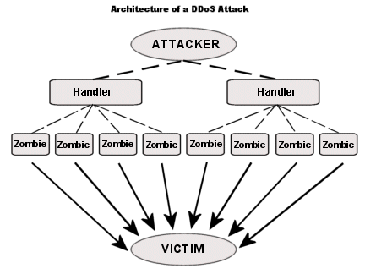
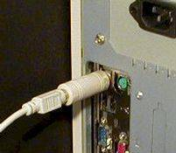
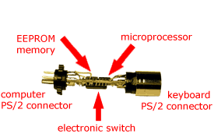
Examples:

Slide 6
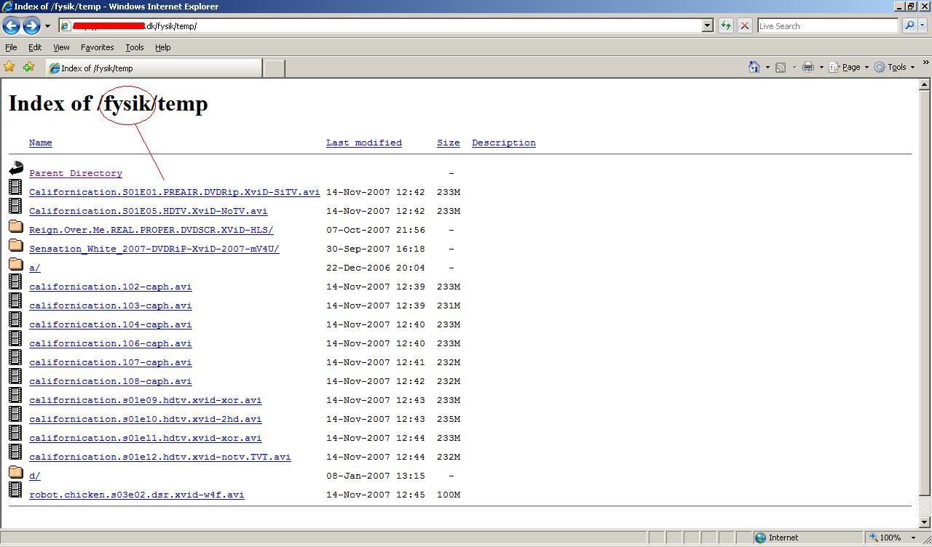

Slide 7
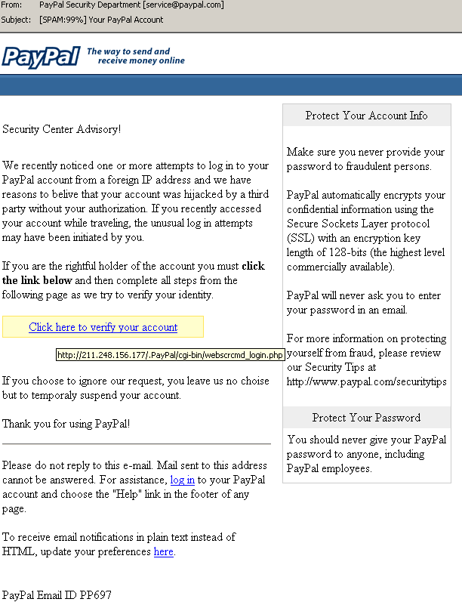
Example of Phishing:

Slide 8
Hackers’ Code of Ethics:
Hacker creed (Steven Levy’s “Hackers: Heroes of Computer Revolution” - 1984 ):
Access to computers should be unlimited and total.
Always yield to the Hands-On Imperative
All information should be free.
Mistrust authority -- promote decentralization.
Hackers should be judged by their hacking.
You can create art and beauty on a computer.
Computers can change your life for the better.

Slide 9
New Code of Ethics (90s) - Steven Mizrach :
"Above all else, do no harm"
Protect Privacy
"Waste not, want not."
Exceed Limitations
The Communicational Imperative
Leave No Traces
Share!
Self Defense
Hacking Helps Security
Trust, but Test!
In Short : 1) protect data and hardware 2) respect and protect privacy 3) utilize what is being wasted by others 4) exceed unnecessary restrictions 5) promote peoples' right to communicate 6) leave no traces 7) share data and software 8) be vigilant against cyber-tyranny and 9) test security and system integrity of computer systems.

Slide 10
New(er) Hacker Ethics:
Hackers share and are willing to teach their knowledge.
Hackers are skilled. Many are self-taught, or learn by interacting with other hackers.
Hackers seek knowledge. This knowledge may come from unauthorized or unusual sources, and is often hidden.
Hackers like to understand how things work, and want to make their own improvements or modifications.
Hackers often disagree with authority, including parents, employers, social customs and laws. They often seek to get around authority they disagree with.
Hackers disagree with each other. Different hackers have different values, and come from all backgrounds. This means that what one hacker is opposed to might be embraced by another.

Slide 11
New(er) Hacker Ethics:
Hackers are persistent, and are willing to devote hours, days and years to pursuing their individual passions.
This Code is not to prescribe how hackers act. Instead, it is to help us to recognize our own diversity and identity.
Every hacker must make his or her own decisions about what is right or wrong, and some might do things they believe are illegal, amoral or anti-social.
Hackers' motivations are their own, and there is no reason for all hackers to agree.
Hackers have a shared identity, however, and many shared interests.
By reading this Code, hackers can recognize themselves and each other, and understand better the group they are a part of.

Slide 12
Hackers’ Code of Ethics:
Old code vs new code
Are new hackers aware of the original hacker ethics?
Are new hackers aware of any hacker ethics?
Influence of technology and social issues on changes in hacker ethics
Similarity between the old and new ethics and ethical continuity

